Slide 1


Bridge of Sighs
Bridges
Rock!
By: Dominic

Slide 2
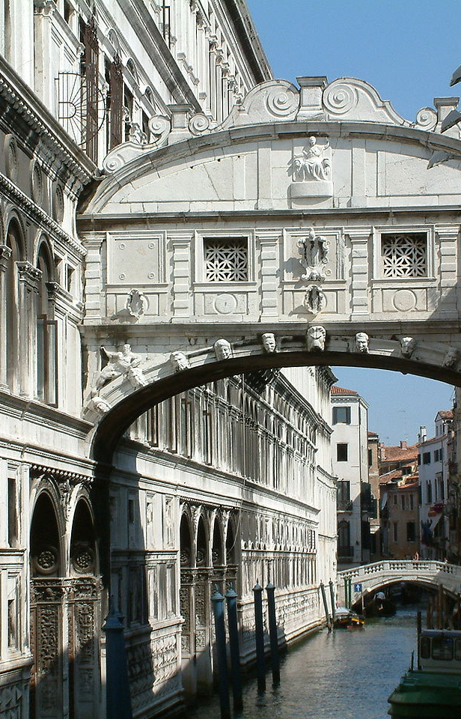
Length
The length of the Bridge of Sighs is 38 feet.

Slide 3

Interesting facts
Visit it on foot because it is part of a government prison
It is made of limestone
It is a sign of love

Slide 4

Architect
Antonio Contin

Slide 5
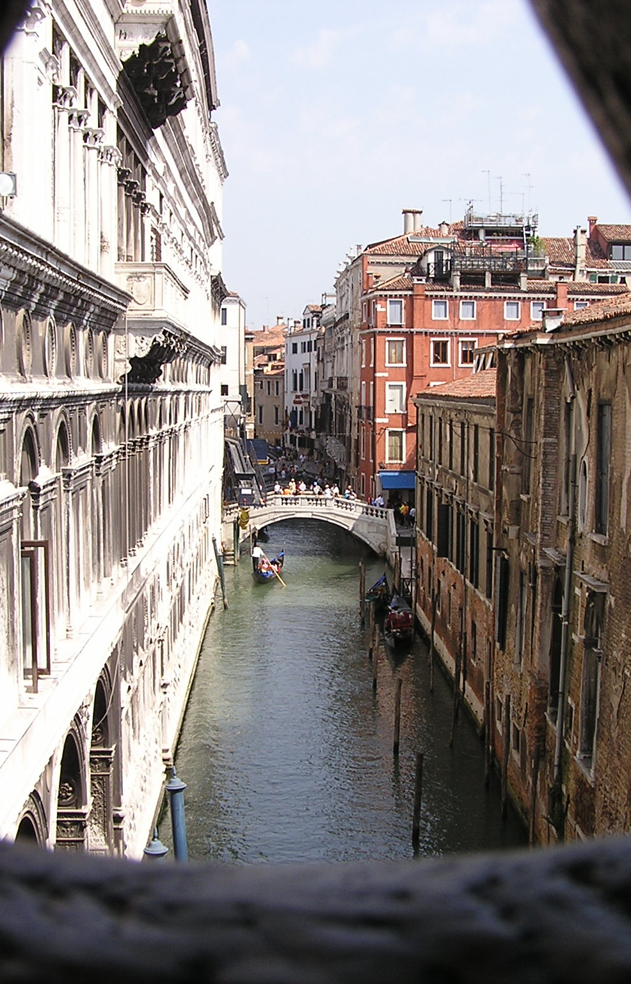
Unique Materials used
Windows
Limestone

Slide 6

Design Features
It is made out of limestone
It connects two walls
It has two windows on each side

Slide 7
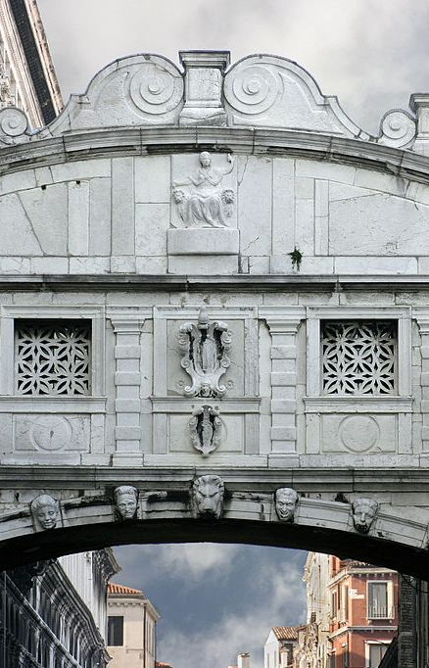
When it was built
It was built in the 1600’s

Slide 8

Location
Venice, Italy

Slide 9
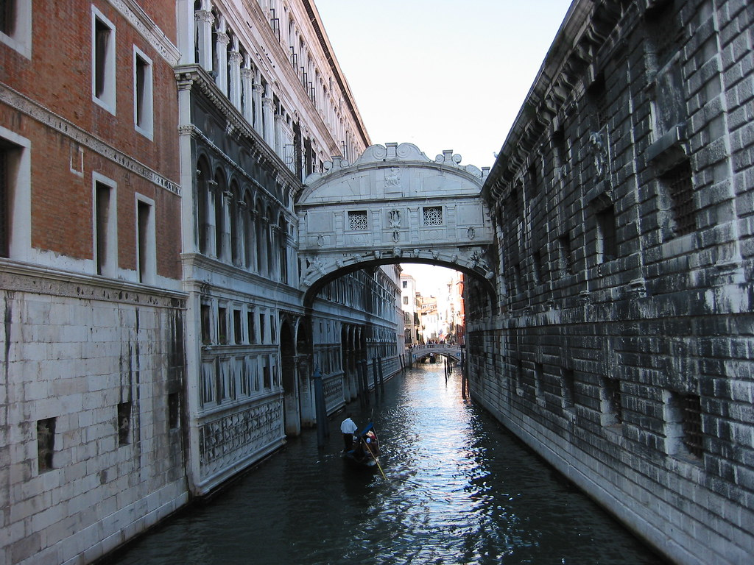
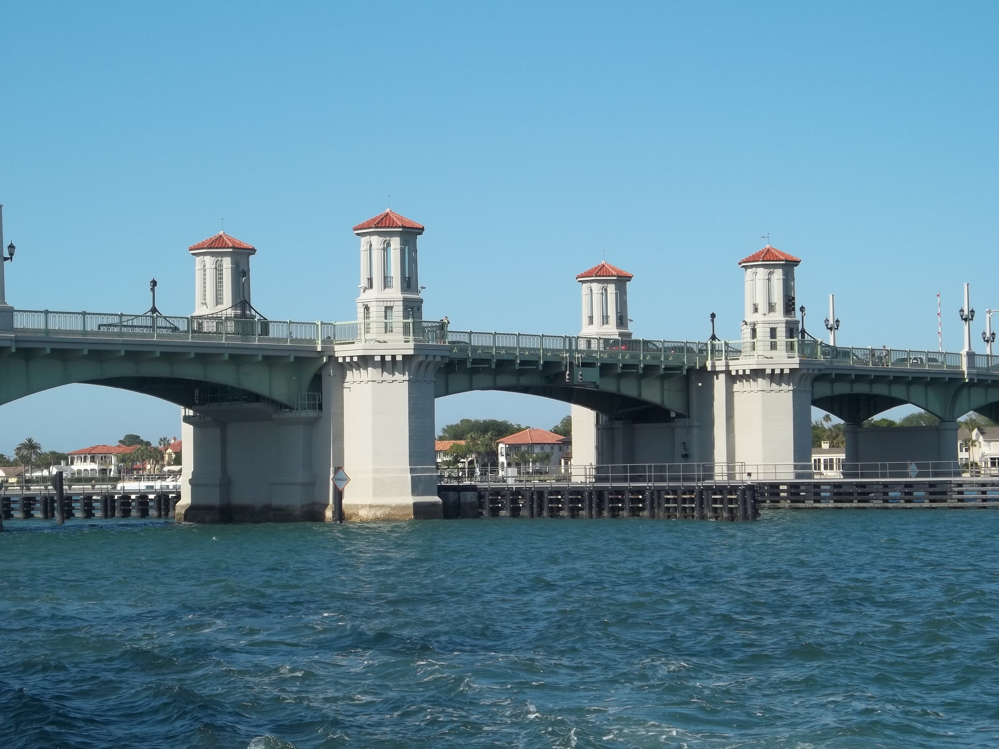
Comparison to The Bridge of Lions
The Bridge of Lions is 1,507 feet longer than the Bridge of Sighs
Bridge of Lions is 1,545 feet long
The Bridge of Sighs 38 feet long
St. Augustine, Florida
Venice, Italy

Slide 10
credits
Thank you by!
Researched and produced by Dominic
3rd grade
Buck Lake Elementary School
Tallahassee, FL

